Slide 1
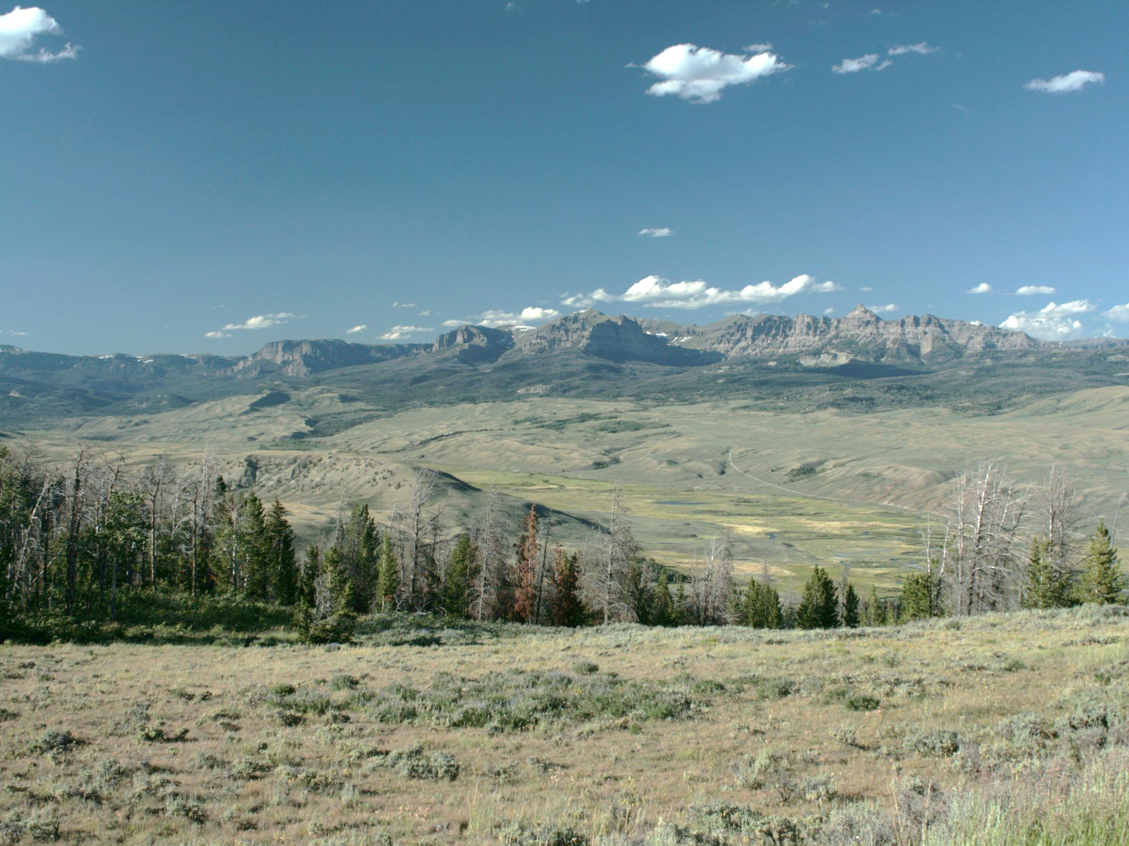
Networks in Landscape Genetics
WHY
Melanie Murphy
University of Wyoming
Collaborators and Co-authors:
Adi Barocas, Ray Dezzani, Rodney Dyer, Jeffrey Evans, Beth Fitzpatrick, Marie-Jose Fortin, W. Chris Funk, Denim Jockimsen, Erin Muths, Ilona Naujokaitis-Lewis, Sara Oyler-McCance, David Pilliod, Rick Scherer Steve Spear, Andrew Storfer, Yessica Rico, Lisette Waits, Victoria Zero
Notes:
Introduce a dataset and walk through with these slides?
Ilona R. Naujokaitis-Lewis

Slide 2
What is a graph?
7
4
5
2
6
1
3
Object (points, nodes, vertices)

Slide 3
What is a graph?
Relationship (lines, edges, arcs)

Slide 4
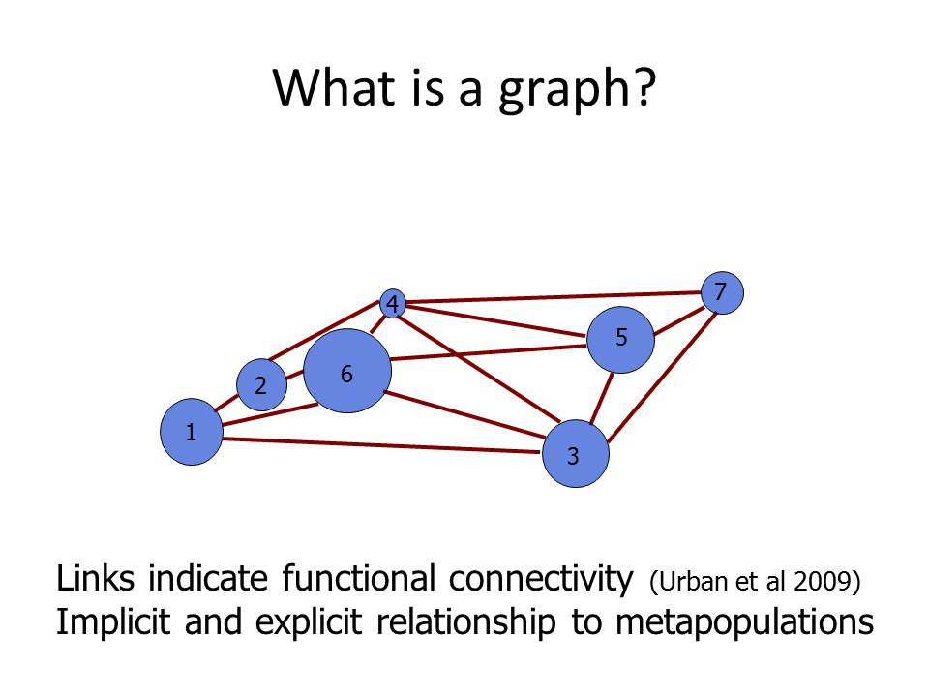

Slide 5
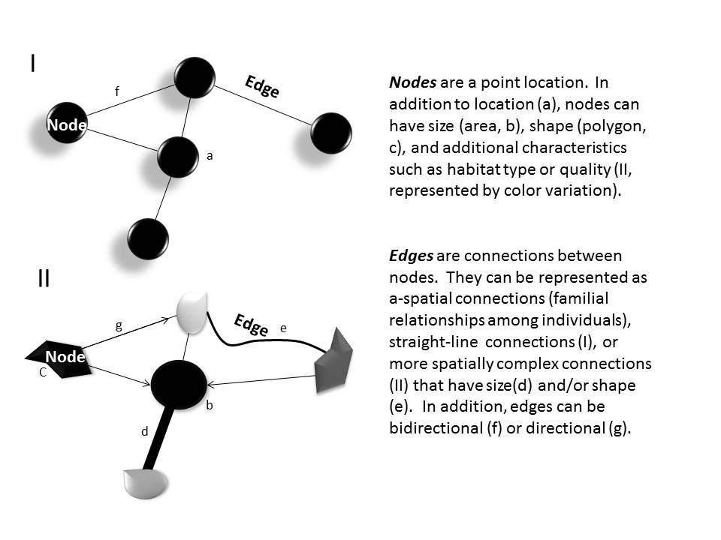
(Murphy, Dyer, Cushman in press; Landscape Genetics: Concepts, Methods, Applications)

Slide 6
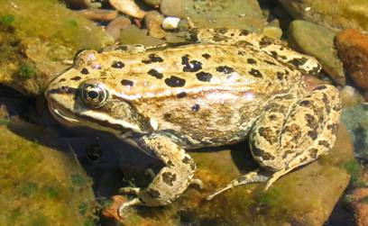
Site Data

Slide 7
Pairwise data
(Murphy, Dyer, Cushman in press; Landscape Genetics: Concepts, Methods, Applications, Storfer et al. 2007; Heredity)
Genetic (dis)similarity

Slide 8
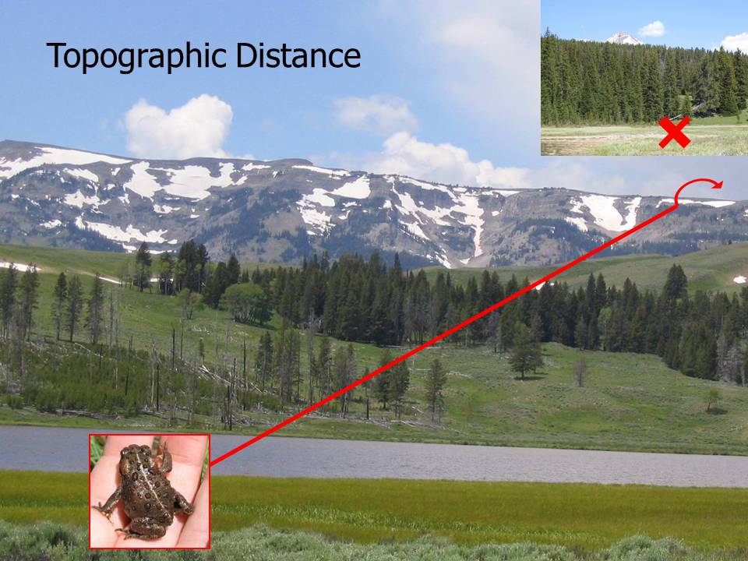
(Murphy et al. 2010, Ecology)

Slide 9
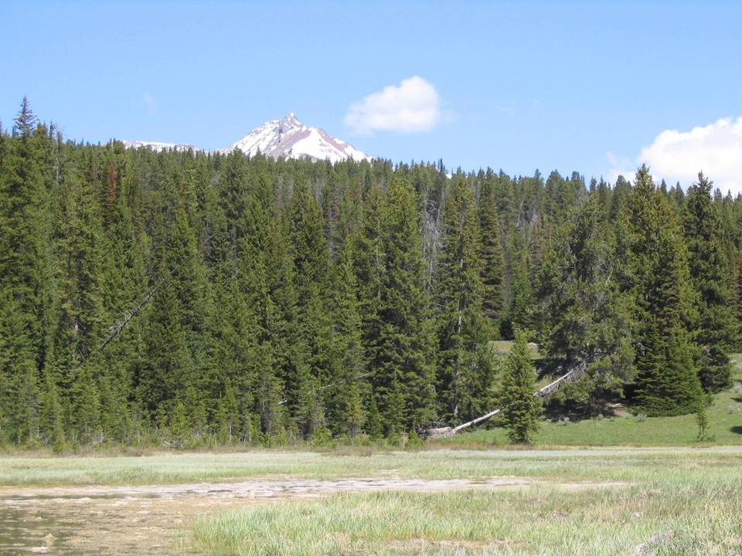
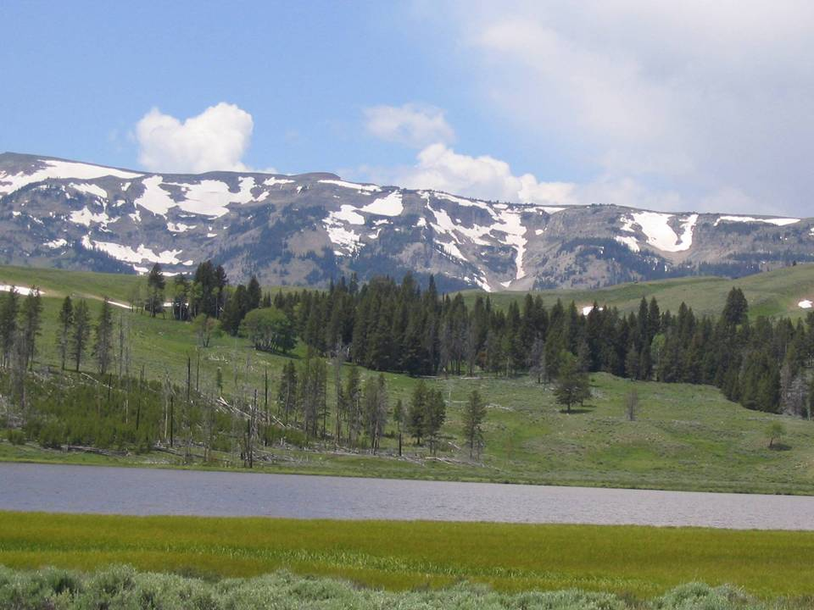
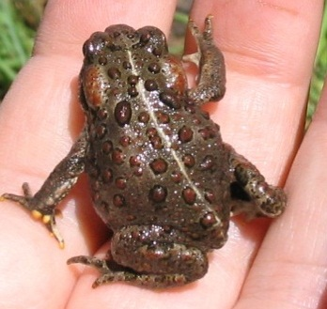
Ecological Process
Habitat Permeability:
burn, cover, roads/development, thermal
(Murphy et al. 2010, Ecology)

Slide 10
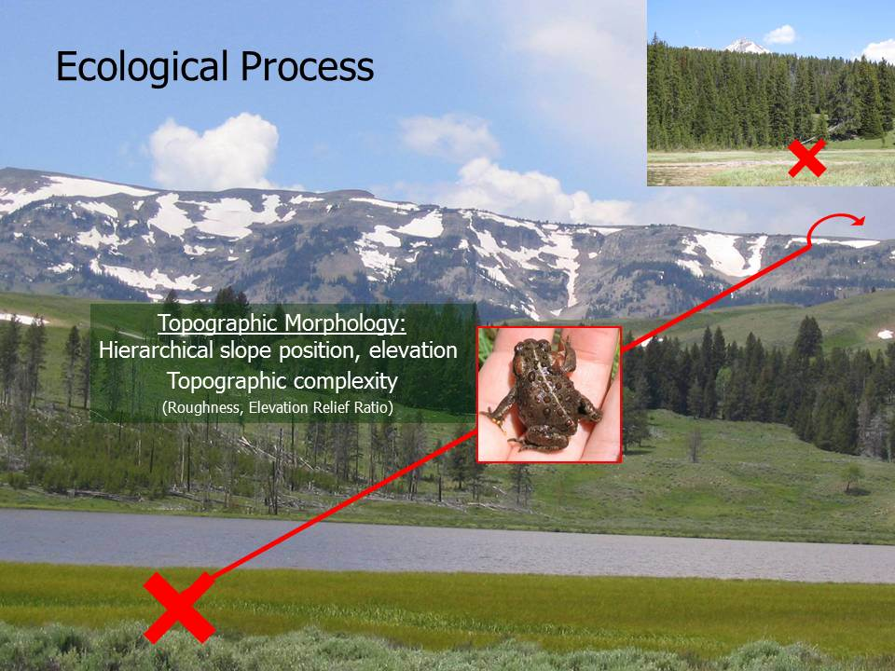
(Murphy et al. 2010, Ecology)

Slide 11
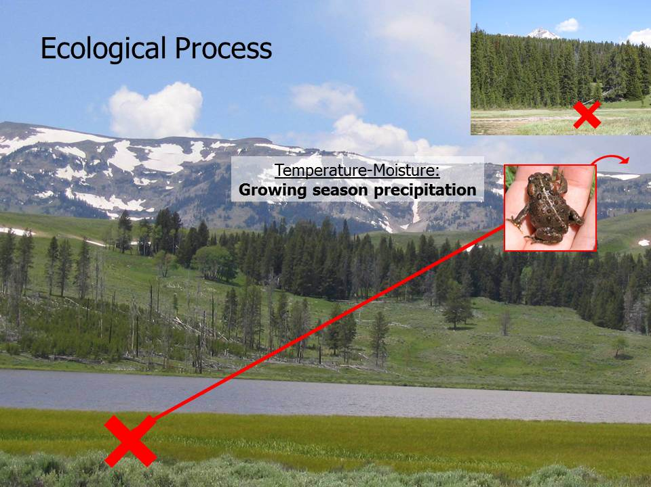
(Murphy et al. 2010, Ecology)

Slide 12
Inherently Network in Structure
(Murphy, Dyer, Cushman in press; Landscape Genetics: Concepts, Methods, Applications)

Slide 13
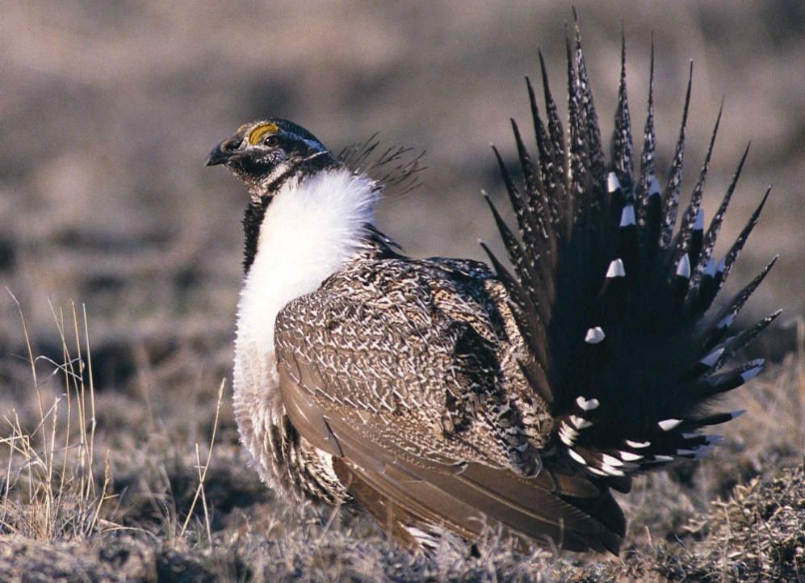

Functional Connectivity Hypotheses
Amount
Configuration
Quality
Interaction
Presence
High quality
habitat
Low quality
habitat
low
high
Absence
Connectivity (gene flow)
(Fitzpatrick & Murphy, in prep)
Notes:
I believe that connectivity will be influenced by the amount of habitat in the landscape. The configuration of habitat (the more dispersed the fragments the lower the connectivity). The quality of the habitat and I think interactions between these characteristics will substantially increase the likelihood of response.

Slide 14
Network “Assumptions”
Nodes easily defined/delineated
Measuring (gene) flow
Connections reasonable estimate of this process
(Murphy, Dyer, Cushman in press; Landscape Genetics: Concepts, Methods, Applications)
Notes:
Type of problems – network structure itself vs. flow through a network.
Need to bring up the point of network vs. interpolation.

Slide 15
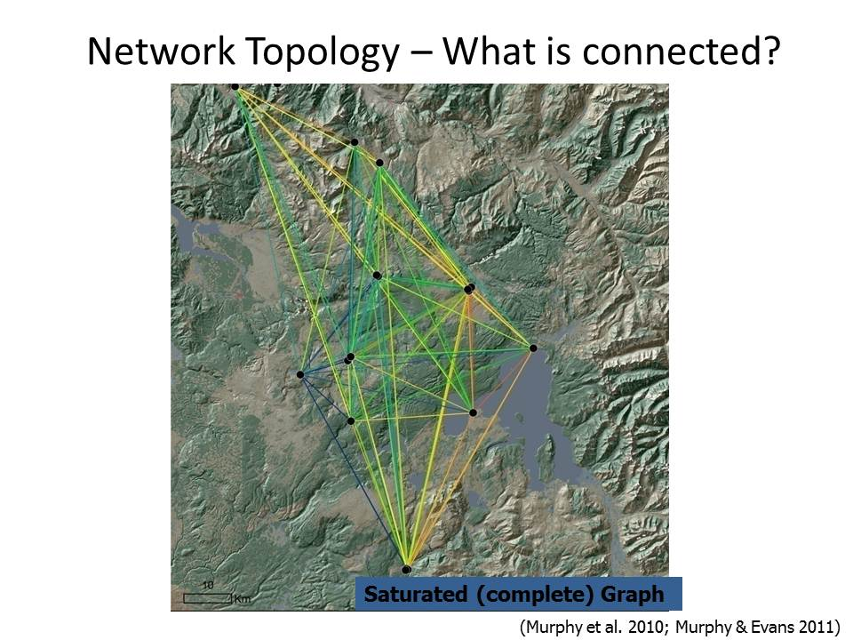

Slide 16
Network Optimization
Reduce problem to relevant edges
Identify connections with highest gene flow
Can avoid overlapping connections
Avoid long edges

Slide 17
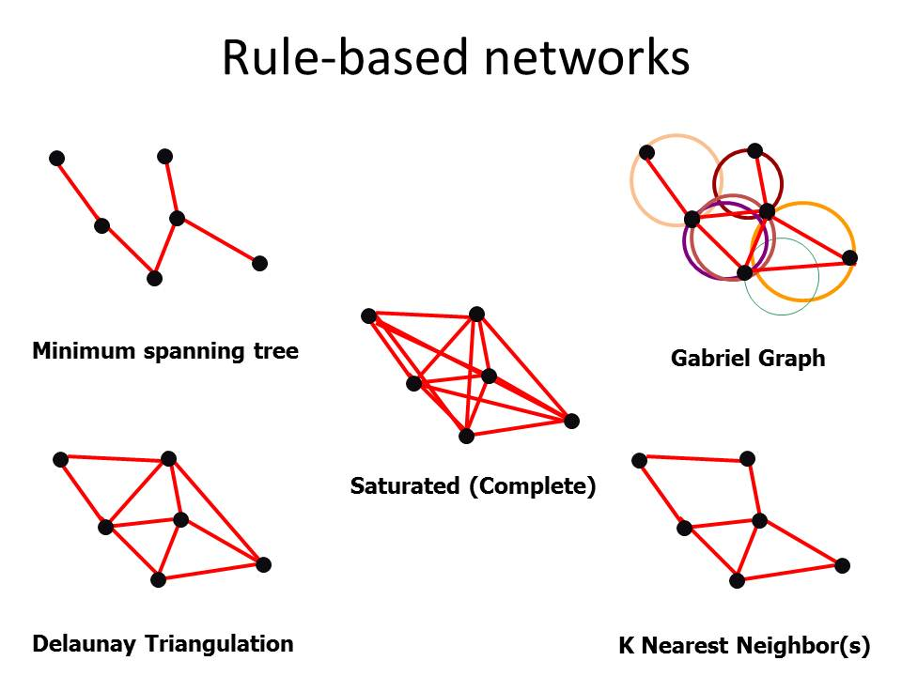

Slide 18
Distance limitation
Landscape Genetics of Wetland Grasshopper
Fst weighted
Gabriel graph
(Keller et al. 2013)
Notes:
Multiple matrix regression. Complete sampling. Switzerland.

Slide 19
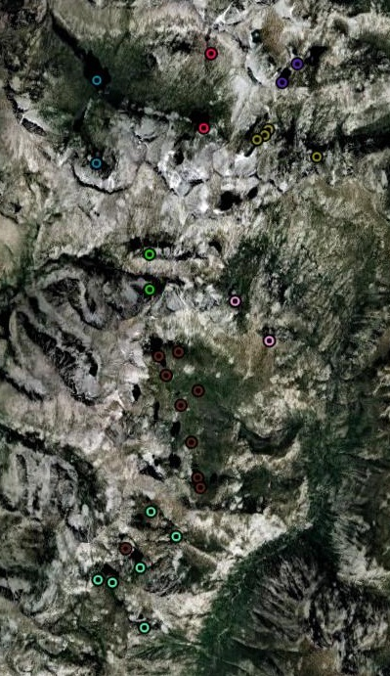
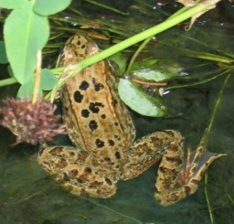
Sensitivity Analysis of Spatial Genetic Networks (DGS 2010)
(Naujokaitis-Lewis et al. 2013; Conservation Genetics)
Network Type
1
2
1
2
3
3
4
4
5
5
6
6
Sampling
1
2
1
2
3
3
4
4
5
5
6
6
(Murphy et al. 2010; Molecular Ecology)

Slide 20
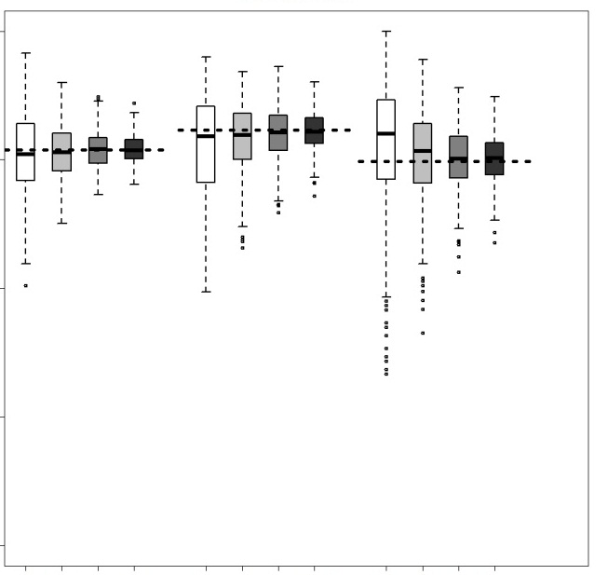
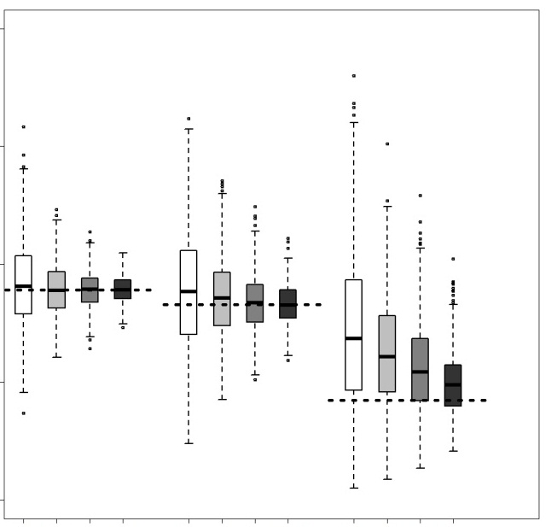
Results for Graph Function: Sensitivity of Landscape Variables
True value
Topographic distance
Elevation relief ratio
1.0
r_{m}
0.0
-1.0
Saturated
Gabriel
MST
Saturated
Gabriel
MST
Sampling
intensity
0.35
0.50
0.65
0.80
Notes:
There is a positive relationship between topographic distance and genetic distance
True Value is in red
Looking within a network type, you see that as the SI decreases there is more divergence of the average across all replicates from the median value (black solid line) and there is a lot more variability around the correlation value
Looking at the influence of network type: we see that networks with fewer links are more sensitive represente
For topographic distance the proportion of significant replicates declined with network complexity (saturated > Gabriel > MST networks, ranked by network complexity) across each sampling intensity level
Next, looking at ERR, in general there is negative correlation between ERR and genetic distance: as ERR increases the genetic distance declines
We see similar patterns as with Topographic distance: as SI declines the avg median value is further from the TV and there is more variability
However, the surprising result of this analysis was that although MST networks showed more divergence from the true rM value relative to saturated and Gabriel networks
Interestingly, the true rM value for the MST network had a moderately strong correlation for elevation relief ratio (rM = -0.58), identifying it as an important predictor of functional connectivity whereas saturated and Gabriel networks had weak correlations
And MST networks had the highest proportion of significant replicates, followed by saturated and then Gabriel networks
This basically tells us that choice of network algorithm can lead to different interpretations of the relative importance of landscape variables on gene flow

Slide 21
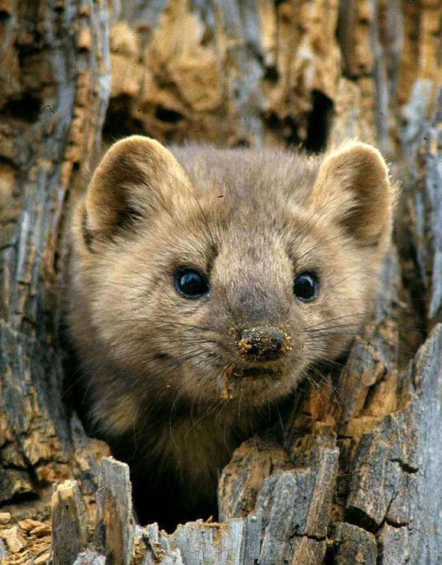
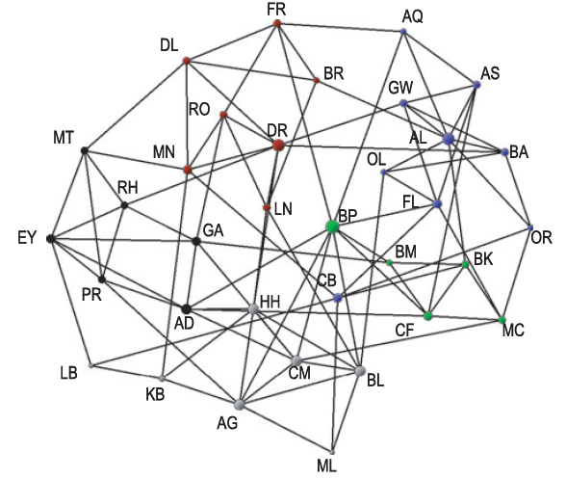
Model Based Network – Population graph (Dyer and Nason 2004)
Prune edges not adding to structure
Nodes scaled to genetic variation
Edges scaled to genetic distance
Relatively assumption free
(Garroway et al 2008; Koen et al 2010)

Slide 22
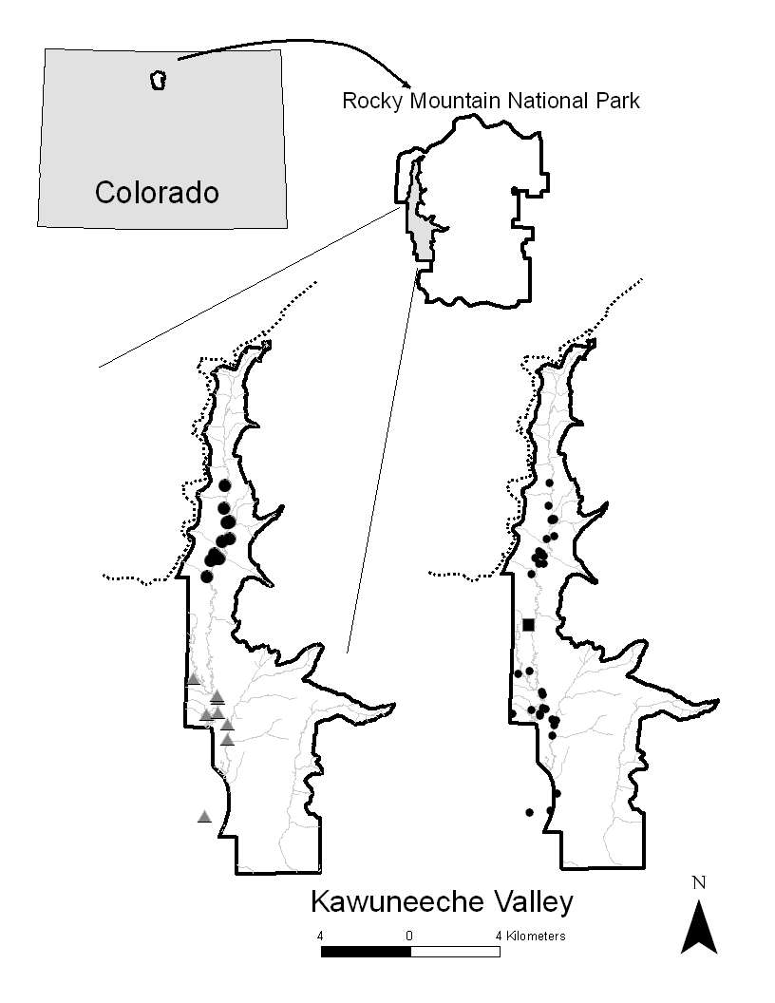
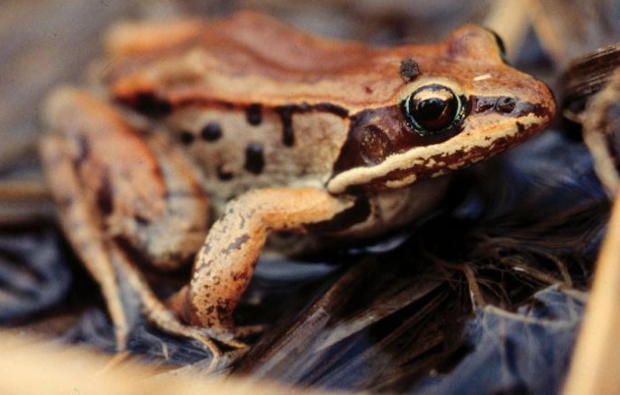
10-30 samples/site (n=160/22)
Microsatellite genotypes (n=8)
(Scherer et al. 2012)
Screened for siblings
(Goldberg & Waits 2010; COLONY - Wang 2004)
Collaborators: Scherer, Muths, Oyler-McCance
(Scherer et al. 2012)

Slide 23
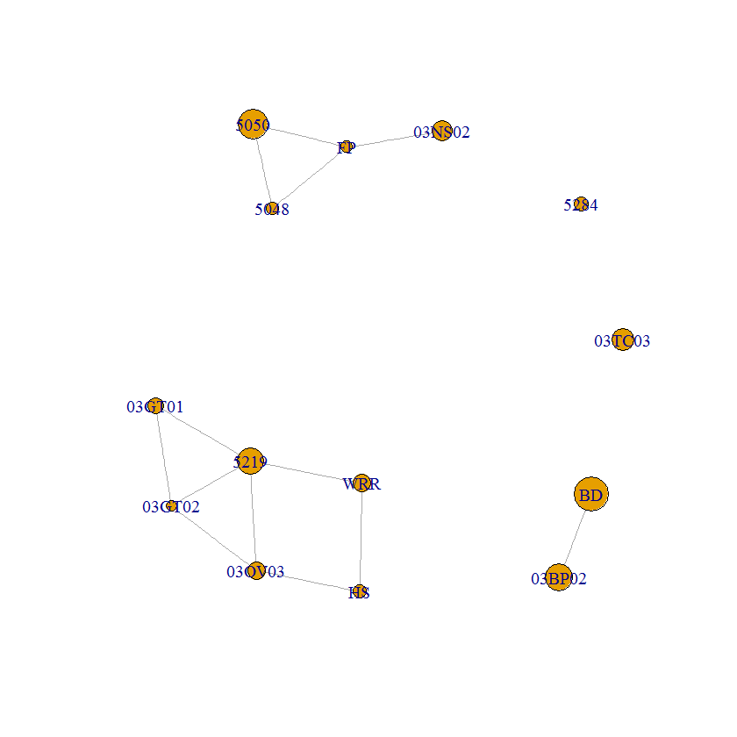
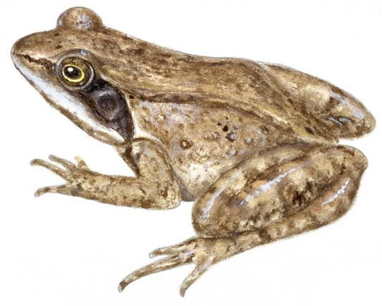

Slide 24
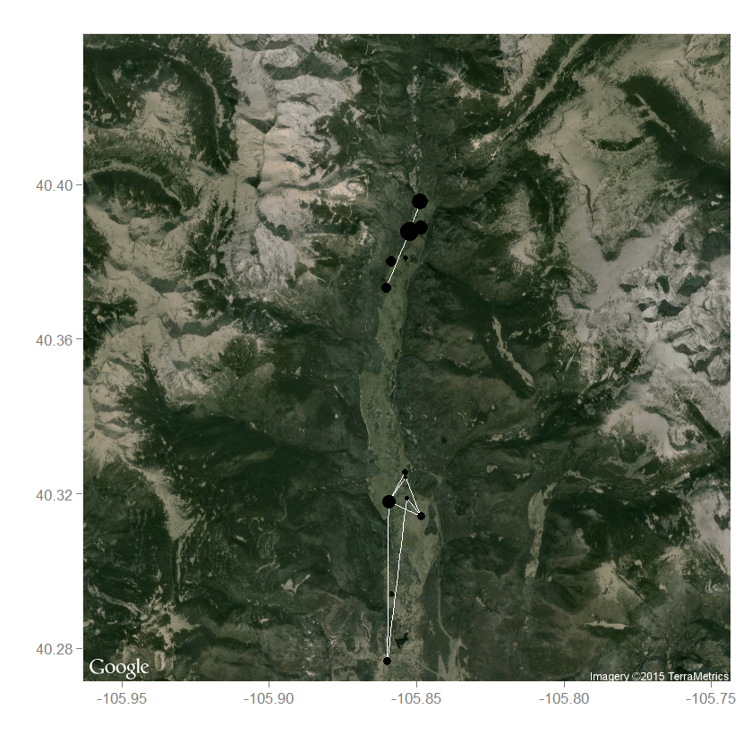

Slide 25
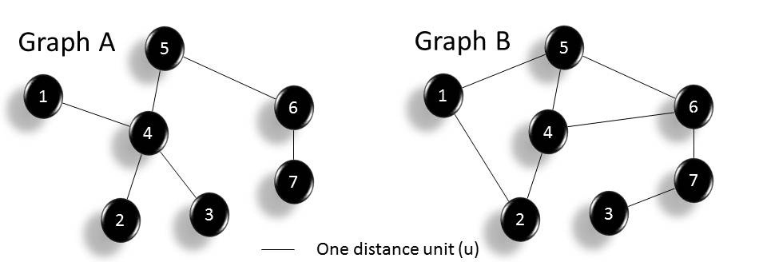
Degree Number of nodes linked to a node
2
3
2
3
4
3
1
2
1
2
1
1
1
2
(Murphy, Dyer, Cushman in press; Landscape Genetics: Concepts, Methods, Applications)

Slide 26
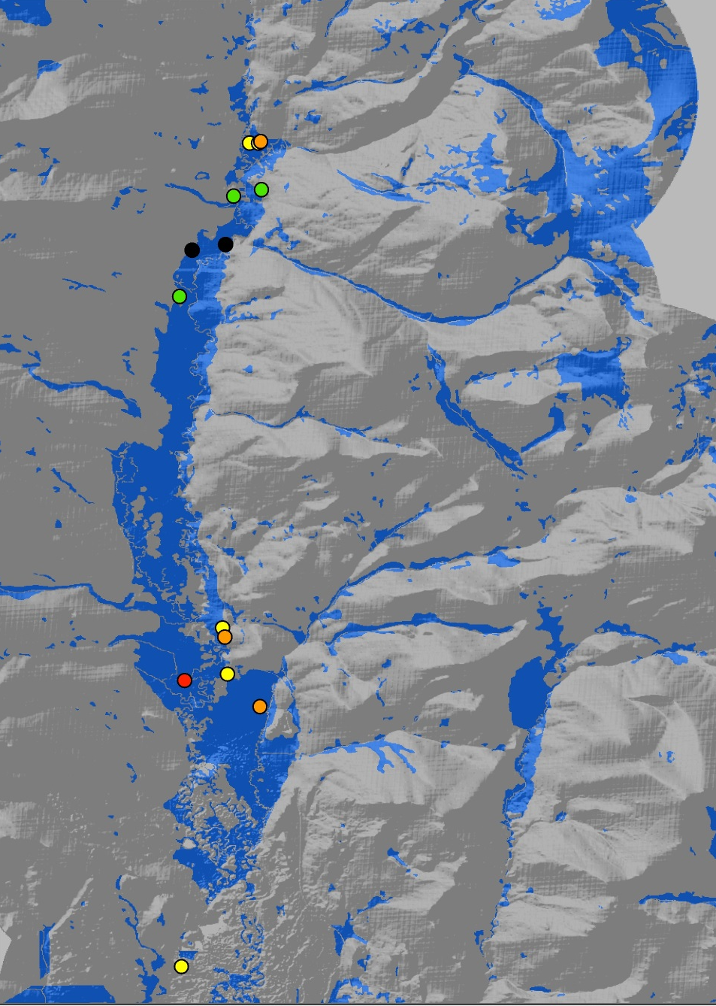
Degree

Slide 27
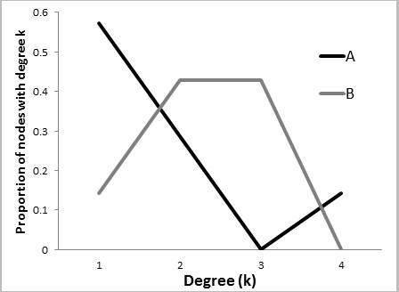
Degree Distribution
2
3
2
3
4
3
1
2
1
2
1
1
1
2
(Murphy, Dyer, Cushman in press; Landscape Genetics: Concepts, Methods, Applications)

Slide 28
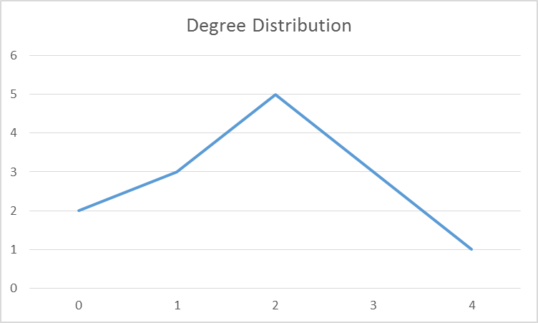
Degree Distribution

Slide 29
Betweenness Number of times node is the shortest path
8
3.5
5
8
12
3.5
0
0.5
0
6
0
0
0
0.5
(Murphy, Dyer, Cushman in press; Landscape Genetics: Concepts, Methods, Applications)

Slide 30
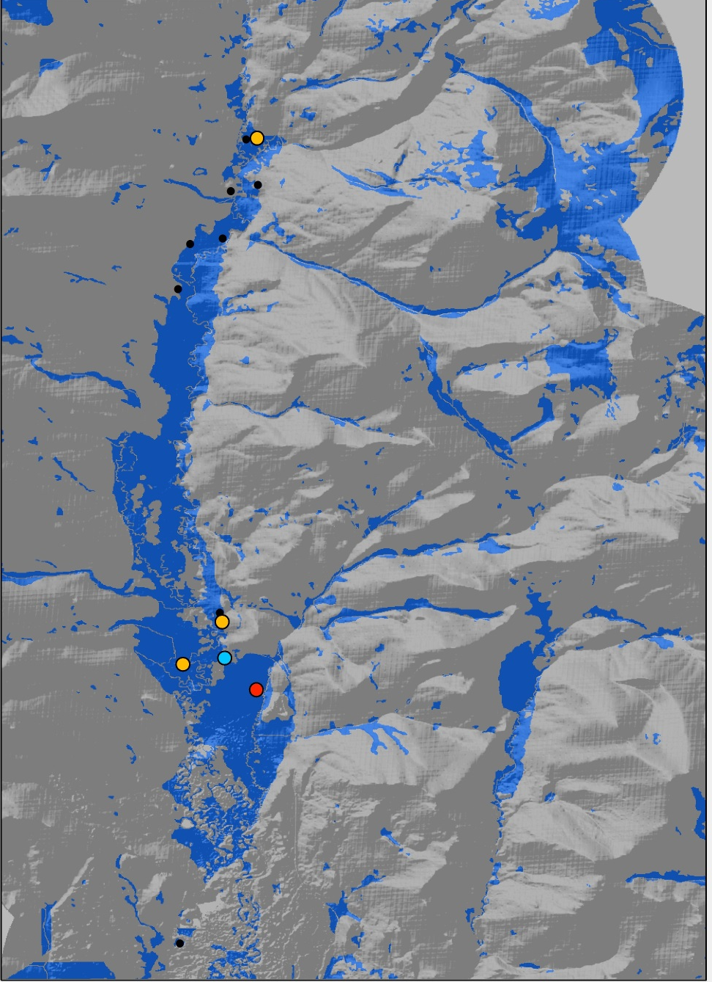
Betweenness
Notes:
Number of times a node acts as shortest path between two nodes. Examples of highly connected and important nodes.

Slide 31
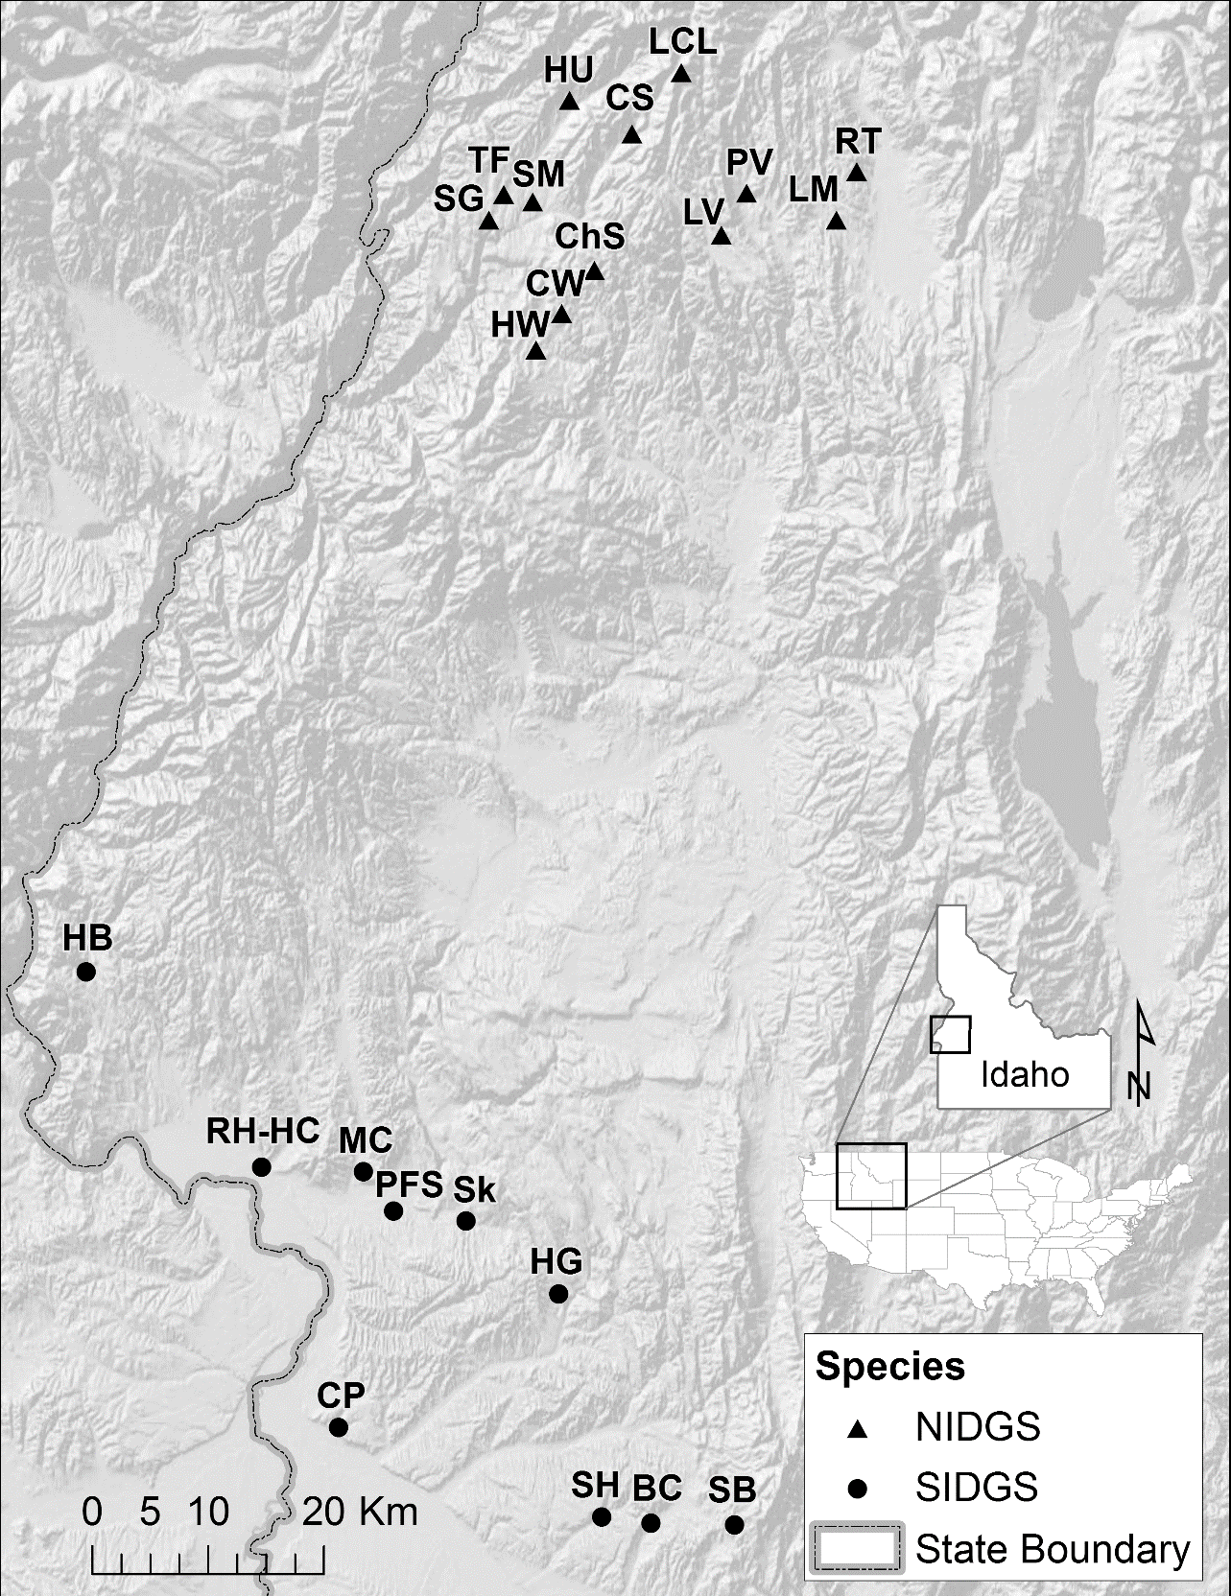
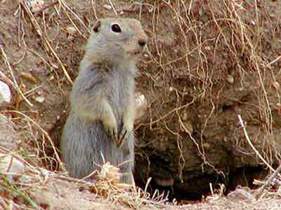
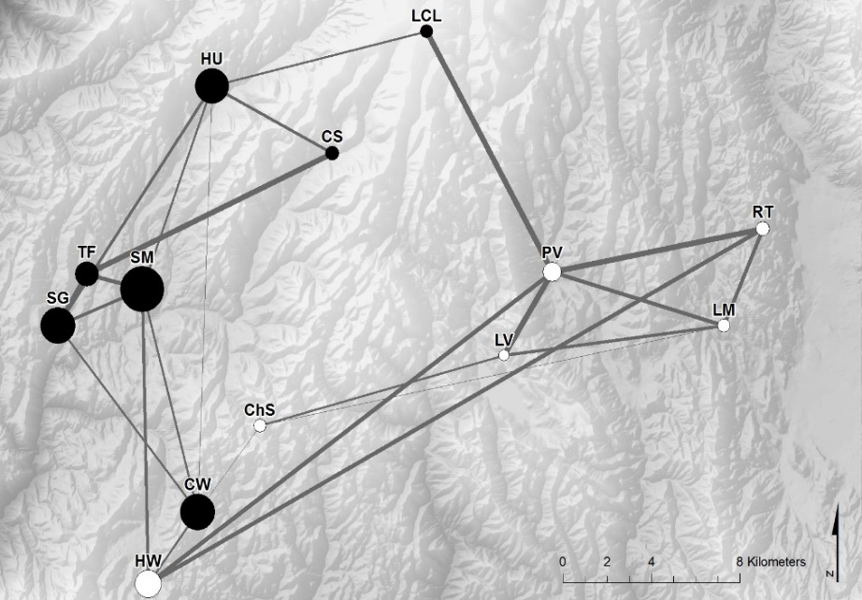
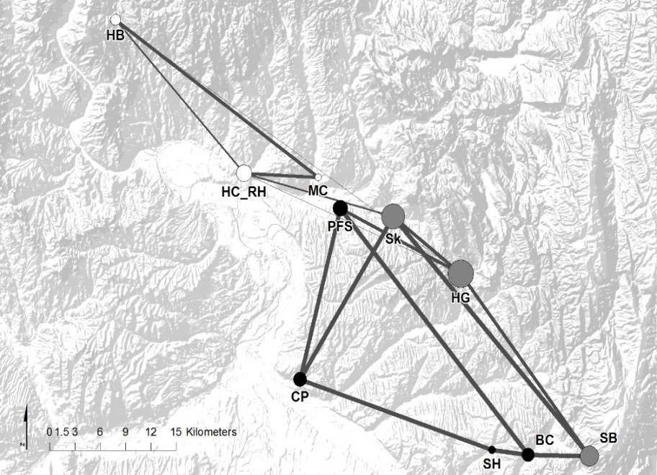
(Zero et al. in revisions)
Notes:
Idaho ground squirrel example

Slide 32
Mean Betweenness
8
3.5
5
8
12
3.5
0
0.5
0
6
0
0
0
0.5
3.57
3.14
(Murphy, Dyer, Cushman in press; Landscape Genetics: Concepts, Methods, Applications)

Slide 33
(Zero et al. in revisions)

Slide 34
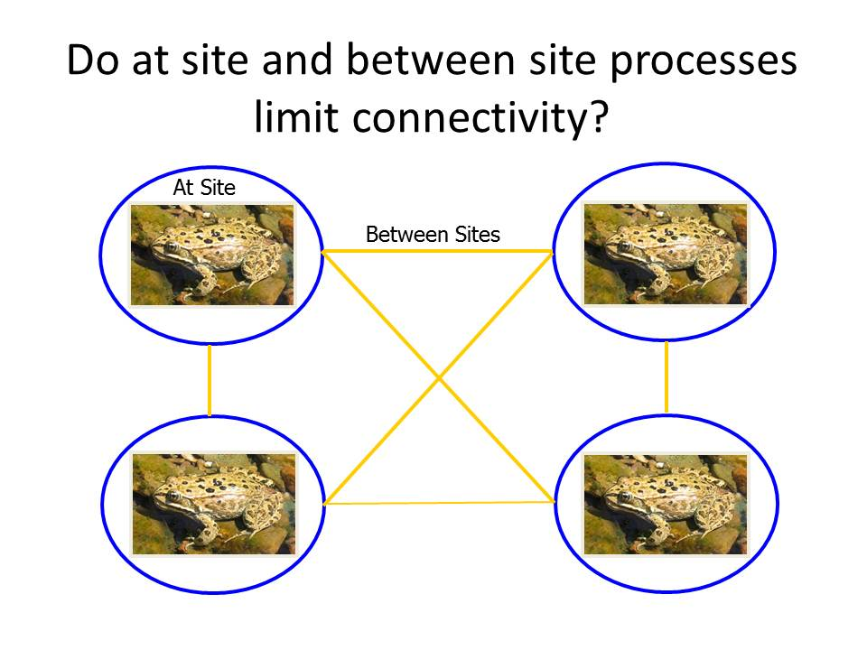

Slide 35
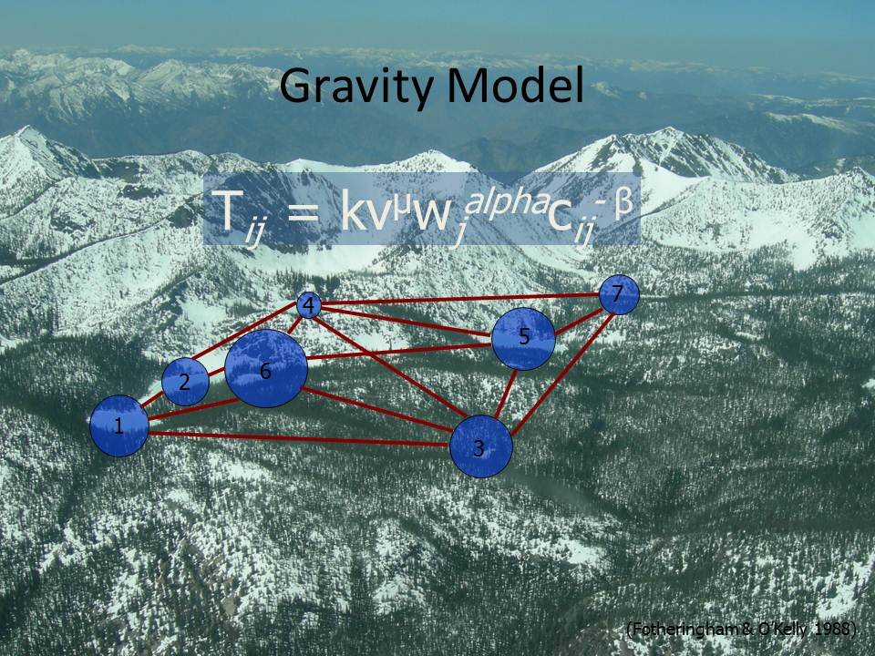

Slide 36
DPS₁₃ = 0.2156

Slide 37
Distance

Slide 38
Production Factors
Attracting Factors

Slide 39
Resistance Factors

Slide 40
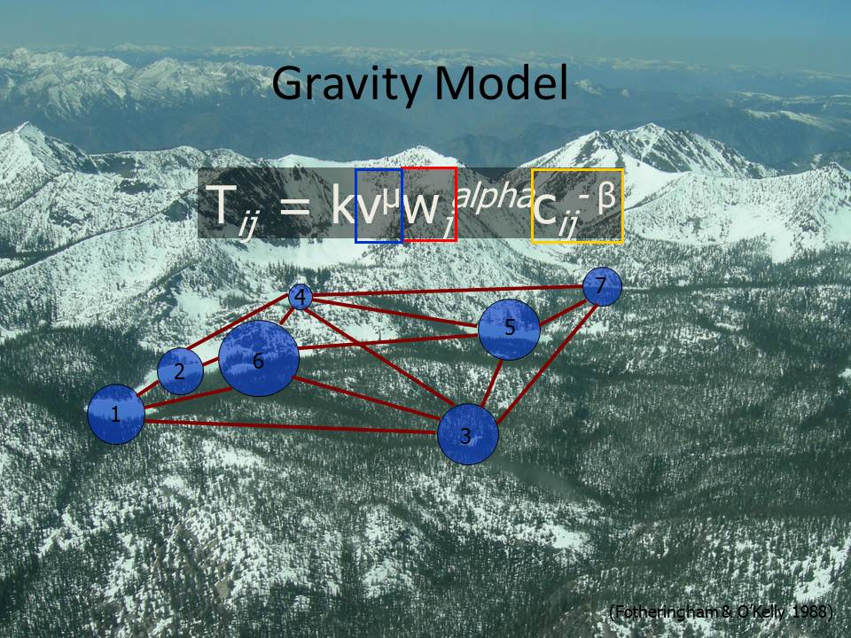
(GenNetIt – Murphy & Evans; CRAN)

Slide 41
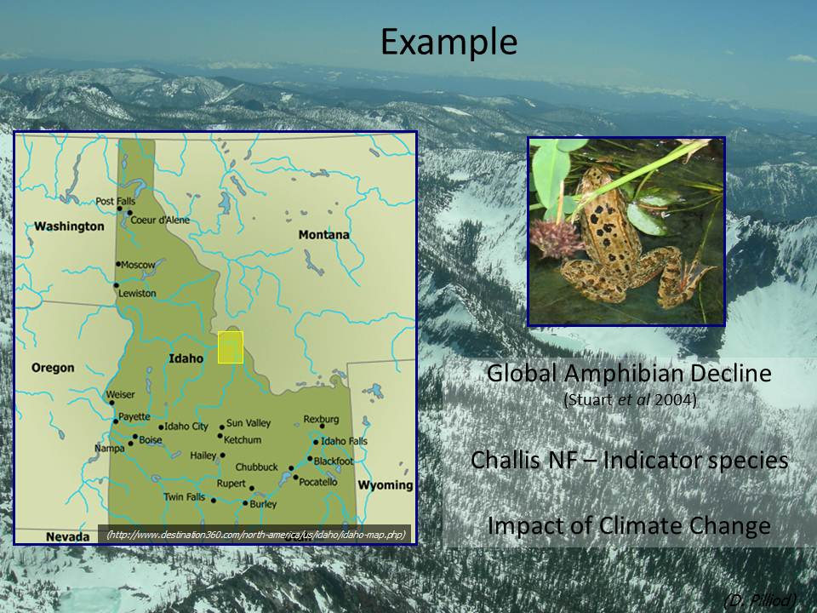

Slide 42
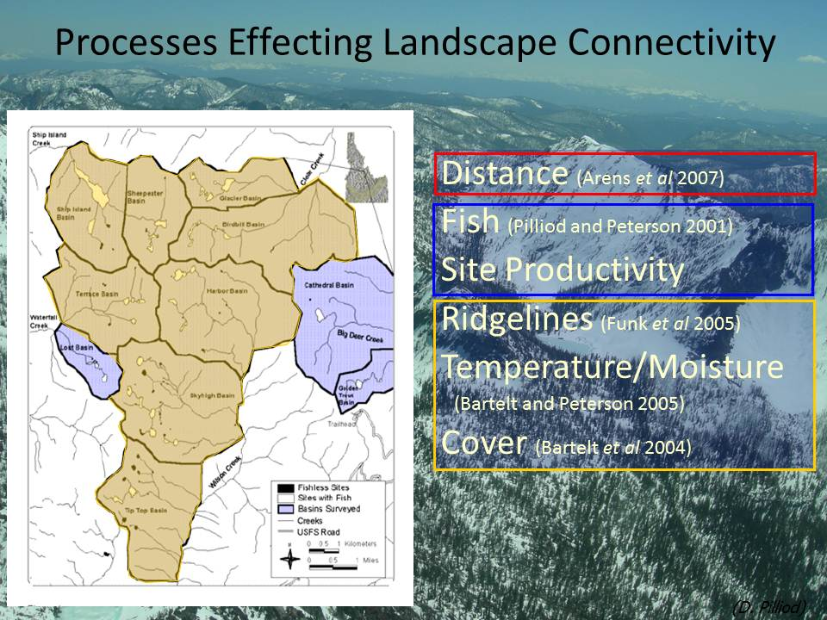

Slide 43
Scale (59.09% Variation Explained)
Scale
0
60
120
240
480
960
forest burn roads canopy rough err27 hsp ridge ffp dd5 ssina gsp
Habitat permeability
Topographic morphology
Temp-moisture (Climate)

Slide 44
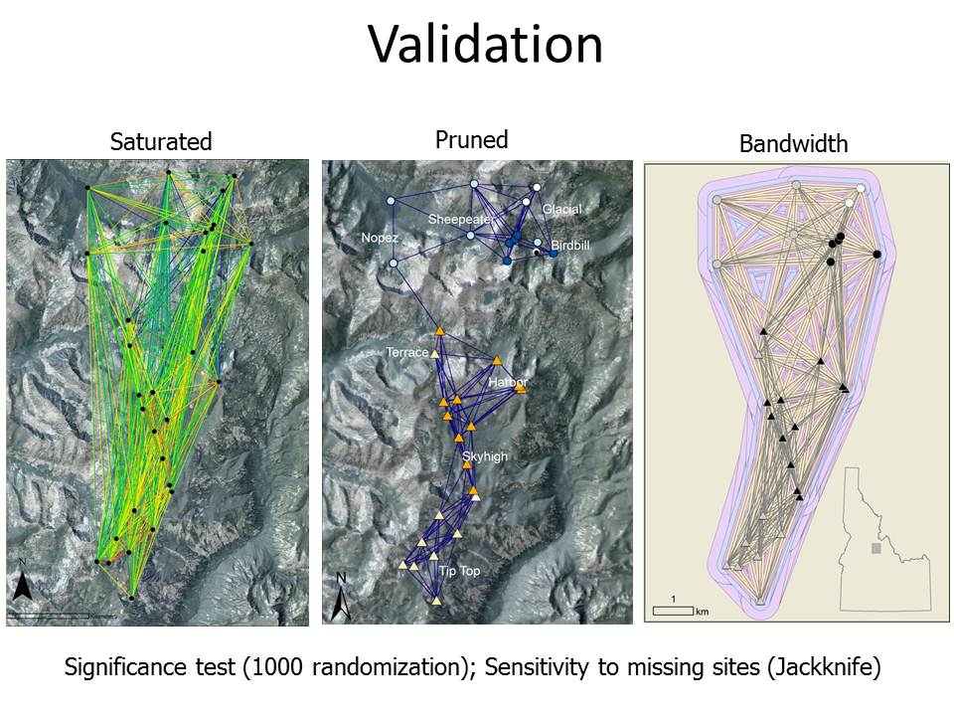

Slide 45
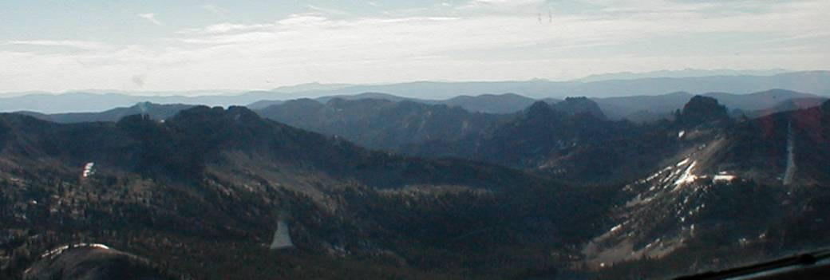
Connectivity is driven by landscape at site and between sites
Depth
HLI
Elevation relief ratio, frost free period
Distance

Slide 46
Recommendations
Clearly ID research questions
Choose an adequate study design
Sensitivity test (missing nodes, band width)
(Murphy, Dyer, Cushman in press; Landscape Genetics: Concepts, Methods, Applications)

Slide 47
Promising Approach in LG
Pairwise geneflow data inherently graph-like in structure
Inferences from graph structure
Topological comparison (hypothesis testing)
Modeling flow through a network

Slide 48
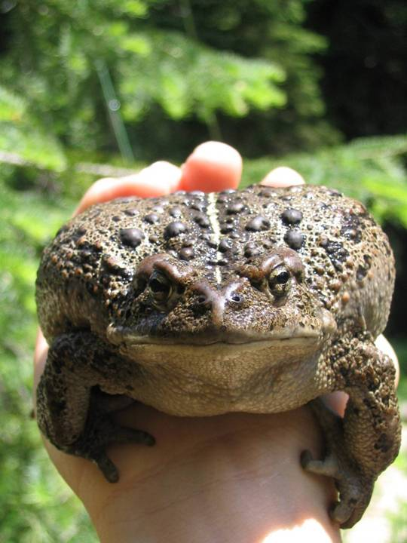
Any Questions?

